Slide 1

Debt, Demographics and AI Dynamism: Who wins?
J U HI D HAWA N
2 7 M A R C H 20 2 6
For institutional use only. Not intended for reproduction or use with the public. Any views expressed herein are those of the author(s), are based on available information, and are subject to change without notice. Individual portfolio management teams may hold different views and may make different investment decisions for different clients. The material and/or its contents are current as of the most recent quarter end, unless otherwise noted. Certain data provided is that of a third party. While data is believed to be reliable, no assurance is being provided as to its accuracy or completeness.

Slide 2
US Outlook
Cycle: Rising tailwinds, fading headwinds, renewed uncertainty
Debt, Demographics & AI-Dynamism: Who Wins
Davos to Donroe: The emerging new world order
S0000043508 P0000140811
2
PPT/ Tmpl 1.6 Copyright © 2026 All Rights Reserved

Slide 3
US Outlook
Cycle: Rising tailwinds, fading headwinds, renewed uncertainty
Debt, Demographics & AI-Dynamism: Who Wins
Davos to Donroe: The emerging new world order
S0000043508 P0000140812
3
PPT/ Tmpl 1.6 Copyright © 2026 All Rights Reserved

Slide 4


US Outlook
Rising tailwinds, fading headwinds, renewed uncertainty
OBBBA and Fed cuts are tailwinds
Tariffs: Bulk of headwind abates
A mid-term election year brings risks and opportunities
Fed: How activist will it get?
S0000043508 P0000140813
PPT/ Tmpl 1.6 Copyright © 2026 All Rights Reserved
4

Slide 5
US: Rising tailwinds
Financial conditions and fiscal impulse are strong positives in early 2026
Index
SAAR, % pt
2.0
70
4
1.5
65
1.0
60
0.5
55
2
0.0
50
-0.5
-1.0
45
0
-1.5
40
-2.0
35
-2.5
95
00
05
10
15
20
25
30
30
-2
00
05
10
15
20
25
30
Financial conditions index (LHS)
Composite ISM (RHS)
Fiscal contribution to growth
Est. of fiscal impulse
Sources: Bureau of Economic Analysis, Hutchins Center, Institute for Supply Management
S0000043508 P0000139709
PPT/ Tmpl 1.6 Copyright © 2026 All Rights Reserved
5

Slide 6
OBBBA Tailwinds
Consumer windfall early ‘26; corporate cashflow also improves
After tax income gains in 2026, %
% chg in tax liability in '26 by share of value added
7
Construction
Miscellaneous Services
6
Administrative Services
Real Estate and Rental and Leasing
5
Accommodation and Food Services
Professional, Scientific, and Technical Services
Percent (%)
4
Retail Trade
Wholesale Trade
3
Finance, Insurance, and Management
Transportation and Warehousing
2
Mining
All Other Industries
1
Information
Manufacturing
0
0 – 20 %
20 – 40 %
40 – 60 % 60 – 80 %
80 – 100 %
-2.5
-2.0
-1.5
-1.0
-0.5
0.0
Sources: Tax Foundation, Joint Committee Taxation x34 – 25
S0000043508 P0000139796
PPT/ Tmpl 1.6 Copyright © 2026 All Rights Reserved
6

Slide 7
Tariff impact should also fade
Old economy manufacturing: Better days ahead
Core capital goods orders, Y/Y % chg.
US IP excl. high tech, Y/Y % change.
30
20
20
15
10
10
5
0
0
-10
-5
-10
-20
-15
-30
93
98
03
08
13
18
23
28
-20
Sources: Federal Reserve, Census Bureau
S0000043508 P0000139798
PPT/ Tmpl 1.6 Copyright © 2026 All Rights Reserved
7

Slide 8
Fading Headwinds
Global manufacturing conditions also stabilizing
Markit PMI, 3m avg.
60
55
50
45
40
11
12
13
14
15
16
17
18
19
20
21 22
23
24
25
26
27
28
Developed PMI
Emerging
Source: S&P Global
S0000043508 P0000140438
PPT/ Tmpl 1.6 Copyright © 2026 All Rights Reserved
8

Slide 9




Mid-term Election Year: Risks and Opportunities
Energy expenditures were contained coming into the Iran conflict
Total Energy expenditures as share of US GDP
Total Energy expenditures as share of Global GDP
14
9
13
8
12
7
11
6
10
5
9
4
8
7
3
6
2
5
1
4
1970 1976 1982 1988 1994 2000 2006 2012 2018 2024 2030
0
1966 1973 1980 1987 1994 2001 2008 2015 2022 2029
Sources: Sources: Energy Information Administration, Bureau of Economic Analysis, Chicago Mercantile Exch, IMF WMC | *YE oil price of $130
S0000043508 P0000140439
PPT/ Tmpl 1.6 Copyright © 2026 All Rights Reserved

Slide 10
Mid-term Election Year: Risks and Opportunities
IEEPA impacts government revenue, consumer prices, and profit margins
Average tariff rate on all imports, %
60
45
30
15
0
1821
1840
1859
1878
1897
1916
1935
1954
1973
1992
2011
2030
Sources: US Treasury, US Census Bureau, Historical Statistics of the United States: Colonial Times to 1970, Part II; US International Trade Commission, “U.S. imports for consumption, duties collected, and ratio of duties to values, 1891 – 2023, (Table 1)”; Tax Foundation calculations. The Budget Lab at Yale.
S0000043508 P0000140439
PPT/ Tmpl 1.6 Copyright © 2026 All Rights Reserved

Slide 11
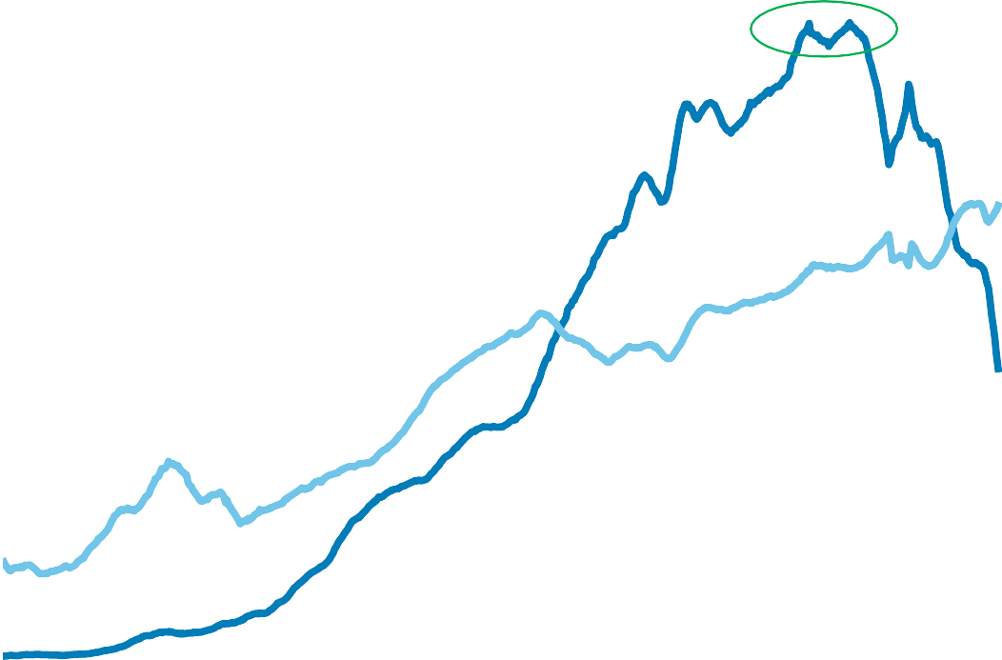
Mid-term Election Year: Risks and Opportunities
USMCA + China trade in focus as Mexican imports surge & China slumps
Share of US imports
25
China
Mexico
20
15
10
5
0
75
80
85
90
95
00
05
10
15
20
25
30
Source: Census Bureau
S0000043508 P0000139822
PPT/ Tmpl 1.6 Copyright © 2026 All Rights Reserved

Slide 12
Mid-term Election Year: Risks and Opportunities
Household income tells the story of affordability
Median real household income, USD
90,000
80,000
70,000
60,000
50,000
84 86 88 90 92 94 96 98 00 02 04 06 08 10 12 14 16 18 20 22 24 26 28 30
Sources: Census Bureau, Federal Reserve Bank of St. Louis
S0000043508 P0000140441
PPT/ Tmpl 1.6 Copyright © 2026 All Rights Reserved

Slide 13
Mid-term Election Year: Risks and Opportunities
Affordability constraints bring housing market into focus
Spread 30-year mortgage-30-year Treasury
4
3
2
1
0
04
06
08
10
12
14
16
18
20
22
24
26
28
30
Sources: WSJ Consumer Rates, Federal Reserve Board
S0000043508 P0000139819
PPT/ Tmpl 1.6 Copyright © 2026 All Rights Reserved

Slide 14
Mid-term election year: Risks and Opportunities
Deregulation takes-off again under President Trump
Number of pages in the federal register
Total cost of regulation by year, % GDP
120,000
5
100,000
4
80,000
3
60,000
2
40,000
1
20,000
0
0
1936
1959
1982
2005
2028
-1
05 07 09 11 13 15 17 19 21 23 25
Sources: The Office of the Federal Register (OFR)
,National Archives and Records Administration (NARA); American Enterprise Institute
S0000043508 P0000140442
PPT/ Tmpl 1.6 Copyright © 2026 All Rights Reserved

Slide 15
Mid-term Election Year: Risks and Opportunities
Stock Market returns typically weakest in mid-term election year
Largest S&P500 price performance
Fiscal deficit as % GDP, FY
Date of midterm election
drawdown in post midterms (%)
10
the 12 months
before the
midterms (%) 12m (%)
Recession at any point?
2 Nov 1926 | -9.40 | 29.30 | Yes
4 Nov 1930 | -34.80 | -38.60 | Yes
6 Nov 1934 | -29.30 | 36.90
8 Nov 1938 | -28.90 | -1.80 | Yes
3 Nov 1942 | -20.50 | 25.30
5 Nov 1946 | -26.60 | 2.90
7 Nov 1950 | -14.00 | 17.30
2 Nov 1954 | -4.40 | 34.00 | Yes
4 Nov 1958 | -5.60 | 8.60
6 Nov 1962 | -28.00 | 25.60
8 Nov 1966 | -22.20 | 17.60
3 Nov 1970 | -29.50 | 10.20 | Yes
3 Nov 1974 | -41.80 | 17.80 | Yes
7 Nov 1978 | -12.90 | 7.80
2 Nov 1982 | -18.90 | 19.00 | Yes
4 Nov 1986 | -9.40 | 1.90
6 Nov 1990 | -19.90 | 24.70 | Yes
8 Nov 1994 | -8.90 | 25.90
3 Nov 1998 | -19.30 | 22.00
5 Nov 2002 | -33.80 | 14.90
7 Nov 2006 | -7.70 | 6.60
2 Nov 2010 | -16.00 | 2.10
4 Nov 2014 | -7.40 | 4.50
6 Nov 2018 | -10.20 | 12.00
8 Nov 2022 | -25.40 | 13.60
0
-10
-20
-30
-40
30 41 52 63 74 85 96 07 18 29
Average
% return
-18.20
14.80
Sources: Longview Economics, Office of Management & Budget, Congressional Budget Office
S0000043508 P0000139800
PPT/ Tmpl 1.6 Copyright © 2026 All Rights Reserved

Slide 16
A more activist Fed?
Warsh as New Fed Chair: Something for everyone
1
Interest rates
2
Balance sheet
3
Deregulation & Supervision
4
Fed architecture
5
Crises management/ Markets
S0000043508 P0000140504
PPT/ Tmpl 1.6 Copyright © 2026 All Rights Reserved

Slide 17
A more activist Fed?
The next Fed chief may revamp the institution’s architecture
US Fed holdings of outstanding treasury securities
40
30
20
10
0
52
58
64
70
76
82
88
94
00
06
12
18
24
30
Source: Federal Reserve Board
S0000043508 P0000140446
PPT/ Tmpl 1.6 Copyright © 2026 All Rights Reserved

Slide 18
US Outlook
Cycle: Rising tailwinds, fading headwinds, renewed uncertainty
Debt, Demographics & AI-Dynamism: Who Wins
Davos to Donroe: The emerging new world order
S0000043508 P0000140814
PPT/ Tmpl 1.6 Copyright © 2026 All Rights Reserved

Slide 19
Debt
US government debt is high and rising
Federal debt held by the public as a % of GDP
120
100
80
COVID
WWII
60
Great Recession
40
Great Depression
20
WWI
Civil War
0
1790
1820
1851
1882
1910
1941
1971
2002
2032
Source: Congressional Budget Office
S0000043508 P0000140703
PPT/ Tmpl 1.6 Copyright © 2026 All Rights Reserved

Slide 20
Debt
Curtail government expenditure or raise government revenue
Federal deficit % GDP
Federal revenue & expenditure as share of GDP
Revenue Expenditure
10
50
40
0
30
-10
20
-20
10
-30
0
1901 | 1922 | 1943 | 1984 | 1985 | 2006 | 2027 | 2027
1901 10 19 38 37 46 55 64 73 82 91 2000 09 18 27
Sources: Congressional Budget Office, Office of Management and Budget
S0000043508 P0000140697
PPT/ Tmpl 1.6 Copyright © 2026 All Rights Reserved

Slide 21
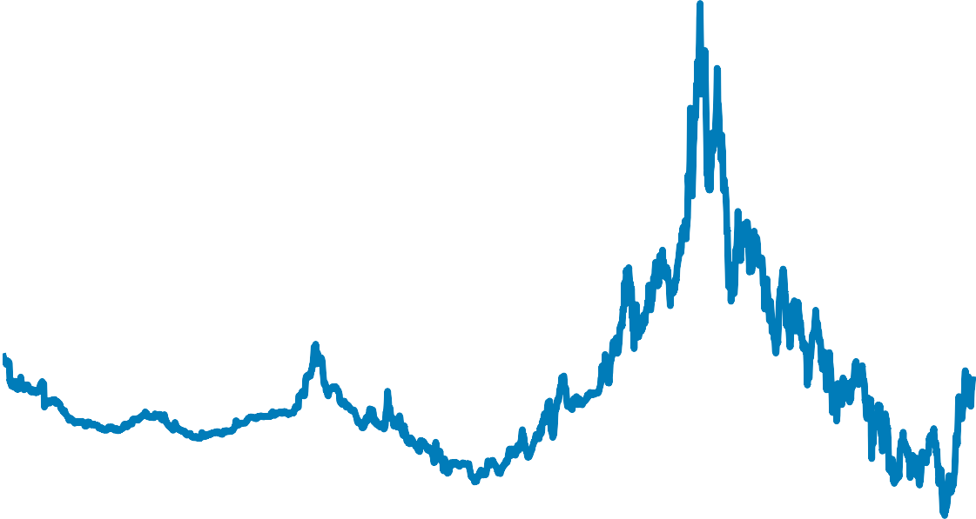
Debt
Higher fiscal deficits risk higher bond yields
10-year bond yield, %
20
16
12
8
4
0
1880 | 1900 | 1920 | 1940 | 1980 | 1990 | 2000 | 2020 | 2030
Sources: Bureau of Labor Statistics, Federal Reserve Bank of NY, Standard & Poor’s, OMB
S0000043508 P0000140698
PPT/ Tmpl 1.6 Copyright © 2026 All Rights Reserved

Slide 22

Demographics
Can closing the US border start to turn the labor share of income?
Compensation as a share of GDP (%)
Undocumented workers, % of labor force by occupation
60
50
58
40
56
30
54
20
52
10
50
48 53 58 63 68 73 78 83 88 93 98 03 08 13 18 23 28
0
Sources: The Burning Glass Institute; Wellington Management; FactSet
S0000043508 P0000140437
PPT/ Tmpl 1.6 Copyright © 2026 All Rights Reserved

Slide 23
Demographics
Social security an important source of income for 65+
Sources of income for 65+ as share of total, 2019
Government transfers as share of personal income
28
Public Assistance
26
24
Other Income
22
Asset Income
20
18
Pensions & Retirement Savings
16
Earnings
14
12
Social Security
10
15
20
25
30
35
10
90 95 00 05
10
15
20 25 30
Source: Congressional Research Service Bureau of Economic Analysis
S0000043508 P0000139805
PPT/ Tmpl 1.6 Copyright © 2026 All Rights Reserved

Slide 24
Demographics
Senior spending power boosted by wealth gains
65+share in population & cons. expenditures
Net Worth, USD trillions
24
100
Cons. expenditures Population
22
80
20
18
60
16
40
14
20
12
10
90
95
00
05
10
15
20
25
0
Millenials
Silent
Gen X
Boomers
Sources: Congressional Research Service, Federal Reserve, Bureau of Economic Analysis, Census Bureau
S0000043508 P0000139804
PPT/ Tmpl 1.6 Copyright © 2026 All Rights Reserved

Slide 25
AI-Dynamism
AI use continues to grow across the economy
% of cos. who used AI in last 2 weeks
% of cos. planning to use AI in next 6 months
20.0
22.5
19.0
22.0
18.0
21.5
17.0
21.0
16.0
11/25
2/26
20.5
11/25
2/26
Sources: Business Outlook and Trends Survey, Weekly, Census Bureau
S0000043508 P0000140607
PPT/ Tmpl 1.6 Copyright © 2026 All Rights Reserved

Slide 26
AI-Dynamism
Government supports AI related capex as a driver of US growth
Y/Y % change, AI related growth
AI related capex as % GDP
1,000
1.5
800
1.2
600
0.9
400
0.6
200
0.3
83%
0
21
22
23
24
25
26
0.0
2019 2020 2021 2022 2023 2024 2025
Sources: Wellington Management, Bureau of Economic Analysis
S0000043508 P0000140443
PPT/ Tmpl 1.6 Copyright © 2026 All Rights Reserved

Slide 27



AI-Dynamism
Unsurprisingly take up of AI is uneven across the economy
% of firms using AI by industry, data as of February 2026
40
35
30
25
20
15
10
5
0
Sources: Business Outlook and Trends Survey, Weekly, Census Bureau
S0000043508 P0000140608
PPT/ Tmpl 1.6 Copyright © 2026 All Rights Reserved

Slide 28



AI-Dynamism
US: Innovation brings productivity gains over time
Productivity 10-year annualized growth rate
5
Automobiles, Electricity
4
Aviation
Internet, Computers
3
2
WWII
1
Global Financial Crisis
Great Depression
Great
Stagflation
WW1
0
-1
1810
1830
1850
1870
1890
1910
1930
1950
1970
1990
2010
2030
Sources: Wellington Management, Maddison, Project Database
S0000043508 P0000140444
PPT/ Tmpl 1.6 Copyright © 2026 All Rights Reserved

Slide 29
AI-Dynamism
Productivity key for keeping inflation in check
Unit labor cost, Y/Y % change
16
Unit labor cost 2q fwd
Core CPI
12
8
4
0
-4
58
63
68
73
78
83
88
93
98
03
08
13
18
23
28
Sources: Bureau of Economic Analysis, Bureau of Labor Statistics
S0000043508 P0000140704
PPT/ Tmpl 1.6 Copyright © 2026 All Rights Reserved

Slide 30
AI-Dynamism
Profit margins tell the tale of improving productivity
S&P 500, Bottom-up Profit Margins
16
S&P 500
S&P 493
12
8
4
0
92 94 96 98 00 02 04 06 08 10
12
14
16
18 20 22 24
Sources: Bloomberg, Standard & Poor’s, Wellington Management, S&P 493 Excludes AMZN, APPL, GOOGL, META, MSFT, NVDA, TSLA
S0000043508 P0000139799
PPT/ Tmpl 1.6 Copyright © 2026 All Rights Reserved

Slide 31
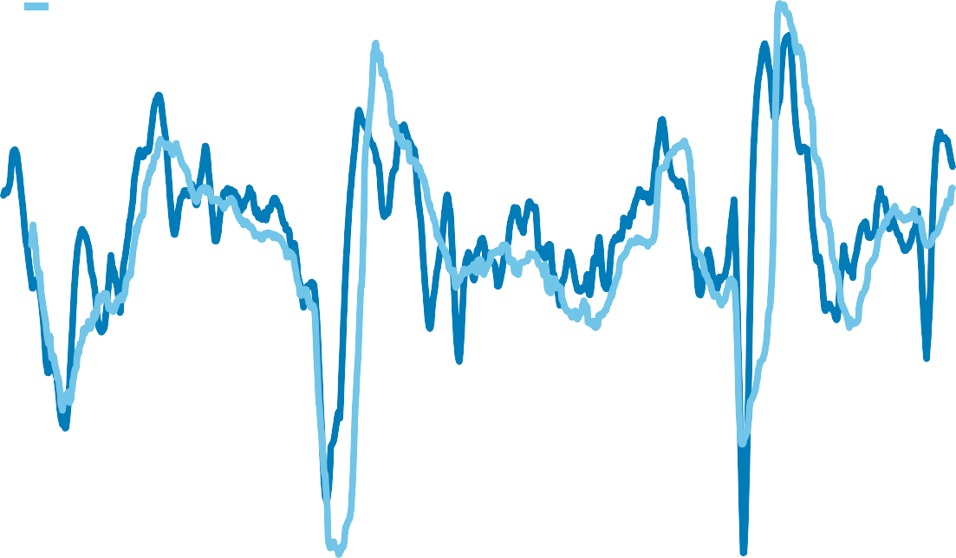
AI-Dynamism
How long will elevated profit expectations last?
S&P 500 EPS 12m forward estimates, % Y/Y 3/mo MA
80
50
Net earnings revisions index (LHS)
Next 12-mo EPS growth (RHS)
60
40
40
30
20
20
10
0
0
-20
-10
-40
-20
-60
-30
-80
00 01 02 03 04 05 06 07 08 09 10 11 12 13 14 15 16 17 18 19 20 21 22 23 24 25 26 27
-40
Sources: Factset, Wellington Management | As of 20 February 2026 | Current next 12-mo EPS = USD 316.81 (16.1 % Y/Y)
S0000043508 P0000139821
PPT/ Tmpl 1.6 Copyright © 2026 All Rights Reserved

Slide 32
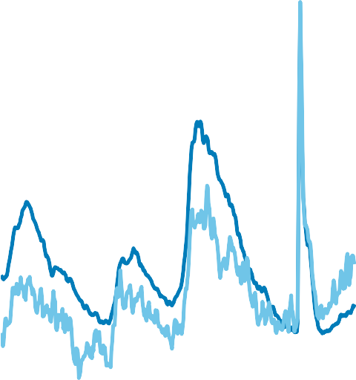

AI-Dynamism
US: Government may need to cushion labor markets
Unemployment rate by sector, %, December 2025
Unemployment rate, %
UR, total UR, recent graduates
16
8
12
6
8
4
4
2
0
0
Sources: U.S. Census Bureau and U.S. Bureau of Labor Statistics, Current Population Survey (IPUMS); U.S. Department of Labor, O*NET.
S0000043508 P0000140445
PPT/ Tmpl 1.6 Copyright © 2026 All Rights Reserved

Slide 33
US Outlook
Cycle: Rising tailwinds, fading headwinds, renewed uncertainty
Debt, Demographics & AI-Dynamism: Who Wins
Davos to Donroe: The emerging new world order
S0000043508 P0000140815
PPT/ Tmpl 1.6 Copyright © 2026 All Rights Reserved

Slide 34
Davos to Donroe: The emerging new world order
A fragmenting geopolitical landscape
A more interventionist Trump administration: Greenland, Venezuela, Iran….
Domestic actions include critical stakes in key industries
Reorientation of trade and capital flows: Western Hemisphere gains prominence over Asia
Greater self-insurance by nation states: Defense spending & energy security gain prominence
S0000043508 P0000140789
PPT/ Tmpl 1.6 Copyright © 2026 All Rights Reserved

Slide 35
Davos to Donroe: The emerging new world order
A wider range of economic and policy outcomes due to the Iran conflict
Historical periods of supply driven oil price increase in history |  |  |  | Change during the period |  |  |  | Avg of 12m quarters from peak |  | Avg of 12 mos from beginning |  | Avg of 12 mos from beginning
Event | Oil price rally beginning | Oil price rally end |  | WTI oil price (%) | Fed fund rate (bps) | 10 yr yield change (bps) |  | Avg US real GDP y/y (%) |  | Avg US CPI y/y (%) |  | 10 yr yield (%)
Yom Kippur War | Sep 1973 | Jan 1974 |  | 135 | -113 | -8 |  | -0.50 |  | 9.70 |  | 7.34
Iranian Revolution | Mar 1979 | Dec 1979 |  | 105 | 369 | 126 |  | -0.30 |  | 12.00 |  | 9.77
Gulf War | Jul 1990 | Sep 1990 |  | 81 | 5 | 42 |  | -0.20 |  | 5.50 |  | 8.42
OPEC supply constraints | Apr 2000 | May 2000 |  | 32 | 25 | 41 |  | 2.50 |  | 3.40 |  | 5.90
Venezuelan oil strike | Nov 2002 | Dec 2002 |  | 12 | -10 | -2 |  | 2.80 |  | 2.40 |  | 4.20
Outages in Venezuela, Iraq, Nigeria | Feb 2008 | Jul 2008 |  | 64 | -97 | 24 |  | -2.40 |  | 3.50 |  | 3.86
Arab Spring | Dec 2010 | Apr 2011 |  | 24 | -8 | 14 |  | 1.70 |  | 3.00 |  | 2.96
Russian invasion | Dec 2021 | Mar 2022 |  | 51 | 12 | 66 |  | 2.10 |  | 8.10 |  | 2.85
Sources: Bloomberg, Haver, Macrobond, UBS. WMC
S0000043508 P0000140449
PPT/ Tmpl 1.6 Copyright © 2026 All Rights Reserved

Slide 36
Davos to Donroe: The emerging new world order
A more interventionist government in strategic industries
Direct stakes in private companies taken by the Trump administration in 2025
Company | Industry | Agency | Return on investment
U.S. Steel | Steel | Committee on Foreign Investment in the United States (CFIUS) | Golden share
MP Materials | Minerals | Defense | 75% stake, plus the right to another 7.5%
AMD | Semiconductors | Commerce | 15% of revenue from chip sales to Chinese buyers
Intel | Semiconductors | Commerce | 9.9% stake
Nvidia | Semiconductors | Commerce | 15% of revenue from chip sales to Chinese buyers
Lithium Americas | Minerals | Energy | 5% stake in Lithium Americas and 5% stake in Thacker Pass joint venture
Westinghouse | Energy (Nuclear) | Commerce | Option to take 8% stake
ReElement Technologies | Minerals | Defense | Right to future stock purchase at set price
Trilogy Metals | Minerals | Defense | 10% stake, plus the right to another 7.5%
Vulcan Elements | Minerals | Commerce | USD 50 million in equity
Vulcan Elements | Minerals | Defense | Right to future stock purchase at set price
Korea Zinc | Minerals | Commerce | 40% stake in joint venture with U.S. partners; 10% stake of company
Nvidia | Semiconductors | Commerce | 25% of revenue from chip sales to Chinese buyers
USA Rare Earth | Minerals | White House | Undisclosed stake in the company
xLight | Semiconductors | Commerce | Undisclosed stake in the company
Sources: The New York Times, Bloomberg, Reuters, CNBC
S0000043508 P0000140449
PPT/ Tmpl 1.6 Copyright © 2026 All Rights Reserved

Slide 37
Davos to Donroe: The emerging new world order
US dollar uptrend has been broken
Real effective exchange rate index
150
135
120
105
90
75
60
73 76 79 82 85 88 91 94 97 00 03 06 09 12
15
18
21 24 27
Source: Federal Reserve
S0000043508 P0000139823
PPT/ Tmpl 1.6 Copyright © 2026 All Rights Reserved

Slide 38
Davos to Donroe: The emerging new world order
Shifting foreign Treasury ownership adds to interest cost burden
Share of foreign ownership of Treasury Market
Net interest cost/Federal Revenues
80
25
20
60
15
40
10
20
5
0
52 57 62 67 72 77 82 87 92 97 02 07 12 17 22 27
0
52 57 62 67 72 77 82 87 92 97 02 07 12 17 22 27
Source: Federal Reserve
S0000043508 P0000140462
PPT/ Tmpl 1.6 Copyright © 2026 All Rights Reserved

Slide 39
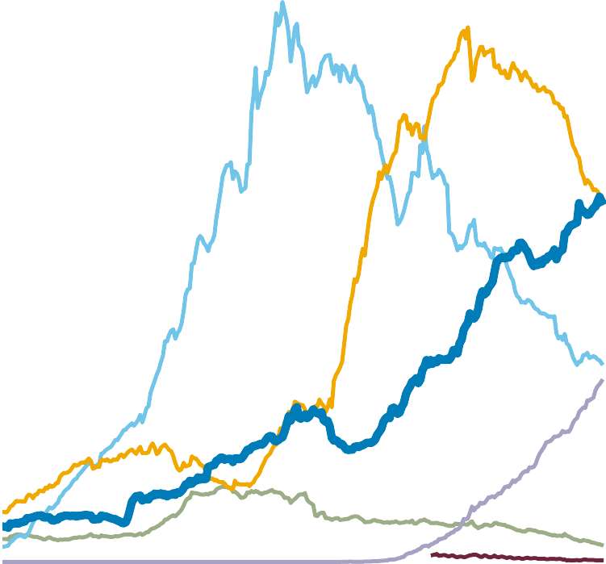
Davos to Donroe: The emerging new world order
As trade policy evolves, foreign capital reassesses US exceptionalism
Share of foreign ownership of corporate bonds
Share of US corporate equities
40
30
25
30
20
20
15
10
10
5
0
52 57 62 67 72 77 82 87 92 97 02 07 12 17 22 27
0
52 57 62 67 72 77 82 87 92 97 02 07 12 17 22 27
Mutual Funds
Life Insurance
Pension Funds
ETFs
Foreigners
Hedge Funds
Source: Federal Reserve
S0000043508 P0000140448
PPT/ Tmpl 1.6 Copyright © 2026 All Rights Reserved

Slide 40
US Outlook
Cycle: Rising tailwinds, fading headwinds, renewed uncertainty
Debt, Demographics & AI-Dynamism: Who Wins
Davos to Donroe: The emerging new world order
S0000043508 P0000140811
PPT/ Tmpl 1.6 Copyright © 2026 All Rights Reserved

Slide 41
Important Notice
Wellington Management Company LLP (WMC) is an independently owned investment adviser registered with the US Securities and Exchange Commission (SEC). WMC is also registered with the US Commodity Futures Trading Commission (CFTC) as a commodity trading advisor (CTA) and commodity pool operator (CPO). WMC serves as a CTA to certain clients including commodity pools operated by registered commodity pool operators. WMC provides commodity trading advice to all other clients in reliance on exemptions from CTA registration. WMC serves as a CPO to Wellington sponsored pooled vehicles. WMC, along with its affiliates (collectively, Wellington Management), provides investment management and investment advisory services to institutions around the world. Wellington Management Group LLP (WMG), a Massachusetts limited liability partnership, serves as the ultimate parent holding company of the Wellington Management global organization. All of the partners are full-time professional members of Wellington Management. Located in Boston, Massachusetts, Wellington Management also has offices in Chicago, Illinois; New York, New York; Radnor, Pennsylvania; San Francisco, California; DIFC, Dubai; Frankfurt; Hong Kong; London; Luxembourg; Madrid; Milan; Shanghai; Singapore; Sydney; Tokyo; Toronto; and Zurich.  This material is prepared for, and authorized for internal use by, designated institutional and professional investors and their consultants or for such other use as may be authorized by Wellington Management. This material and/or its contents are current at the time of writing and may not be reproduced or distributed in whole or in part, for any purpose, without the express written consent of Wellington Management. This material is not intended to constitute investment advice or an offer to sell, or the solicitation of an offer to purchase shares or other securities. Investors should always obtain and read an up-to-date investment services description or prospectus before deciding whether to appoint an investment manager or to invest in a fund. Any views expressed herein are those of the author(s), are based on available information, and are subject to change without notice. Individual portfolio management teams may hold different views and may make different investment decisions for different clients. While any third-party data used is considered reliable, its accuracy is not guaranteed. Forward-looking statements should not be considered as guarantees or predictions of future events. Past results are not a reliable indicator of future results.
Wellington assumes no duty to update any information in this material in the event that such information changes.
In Canada, this material is provided by Wellington Management Canada ULC, a British Columbia unlimited liability company registered in the provinces of Alberta, British Columbia, Manitoba, New Brunswick, Newfoundland and Labrador, Nova Scotia, Ontario, Prince Edward Island, Quebec, and Saskatchewan in the categories of Portfolio Manager and Exempt Market Dealer. In Europe (excluding the United Kingdom and Switzerland), this material is provided by the marketing entity Wellington Management Europe GmbH (WME) which is authorized and regulated by the German Federal Financial Supervisory Authority (Bundesanstalt für Finanzdienstleistungsaufsicht – BaFin). This material may only be used in countries where WME is duly authorized to operate and is only directed at eligible counterparties or professional clients as defined under the German Securities Trading Act. This material does not constitute investment advice, a solicitation to invest in financial instruments or information recommending or suggesting an investment strategy within the meaning of Section 85 of the German Securities Trading Act (Wertpapierhandelsgesetz).  In the United Kingdom, this material is provided by Wellington Management International Limited (WMIL), a firm authorized and regulated by the Financial Conduct Authority (FCA) in the UK (Reference number: 208573). This material is directed only at eligible counterparties or professional clients as defined under the rules of the FCA.  In Switzerland, this material is provided by Wellington Management Switzerland GmbH, a firm registered at the commercial register of the canton of Zurich with number CH-020.4.050.857-7. This material is directed only at Qualified Investors as defined in the Swiss Collective Investment Schemes Act and its implementing ordinance.  In Dubai, this material is provided by Wellington Management (DIFC) Limited (WM DIFC), a firm registered in the DIFC with number 7181 and regulated by the Dubai Financial Services Authority (“DFSA”). To the extent this document relates to a financial product, such financial product is not subject to any form of regulation or approval by the DFSA. The DFSA has no responsibility for reviewing or verifying any prospectus or other documents in connection with any financial product to which this document may relate. The DFSA has not approved this document or any other associated documents nor taken any steps to verify the information set out in this document, and has no responsibility for it. Any financial product to which this document relates may be illiquid and/or subject to restrictions on its resale. Prospective purchasers should conduct their own due diligence on any such financial product. If you do not understand the contents of this document you should consult an authorised financial adviser. This document is provided on the basis that you are a Professional Client and that you will not copy, distribute or otherwise make this material available to any person.  In Hong Kong, this material is provided to you by Wellington Management Hong Kong Limited (WM Hong Kong), a corporation licensed by the Securities and Futures Commission to conduct Type 1 (dealing in securities), Type 2 (dealing in futures contracts), Type 4 (advising on securities), and Type 9 (asset management) regulated activities. By accepting this material you acknowledge and agree that this material is provided for your use only and that you will not distribute or otherwise make this material available to any person.  Wellington Private Fund Management (Shanghai) Limited (WPFM), which is an unregulated entity incorporated in China, is a wholly-owned subsidiary of WM Hong Kong. Wellington Global Private Fund Management (Shanghai) Limited (WGPFM) is a wholly-owned entity and subsidiary of WPFM and is registered as a private fund manager with Asset Management Association of China to conduct qualified domestic limited partnership and management activities. In mainland China, this material is provided for your use by WPFM, WGPFM, or WMHK (as the case may be).  In Singapore, this material is provided for your use only by Wellington Management Singapore Pte Ltd (WM Singapore) (Registration Number 201415544E). WM Singapore is regulated by the Monetary Authority of Singapore under a Capital Markets Services License to conduct fund management activities and deal in capital markets products, and is an exempt financial adviser. By accepting this material you represent that you are a non-retail investor and that you will not copy, distribute or otherwise make this material available to any person.  In Australia, Wellington Management Australia Pty Ltd (WM Australia) (ABN 19 167 091 090) has authorized the issue of this material for use solely by wholesale clients (as defined in the Corporations Act 2001). By accepting this material, you acknowledge and agree that this material is provided for your use only and that you will not distribute or otherwise make this material available to any person.  In Japan, Wellington Management Japan Pte Ltd (WM Japan) (Registration Number 199504987R) has been registered as a Financial Instruments Firm with registered number: Director General of Kanto Local Finance Bureau (Kin-Sho) Number 428. WM Japan is a member of the Japan Investment Advisers Association (JIAA), the Investment Trusts Association, Japan (ITA) and the Type II Financial Instruments Firms Association (T2FIFA).  WM Hong Kong and WM Japan are also registered as investment advisers with the SEC; however, they will comply with the substantive provisions of the US Investment Advisers Act only with respect to their US clients.
©2025 Wellington Management Company LLP. All rights reserved. | As of 1 July 2025
S0000006515 P0000076572
PPT/ Tmpl 1.6 Copyright © 2026 All Rights Reserved

